Slide 1


OOP
جامعة المرقب
كلية تقنية المعلومات
Abstraction
خريف 2026/2025‏

Slide 2


Abstraction Example
The process of defining the behavior and tasks performed by the object and ignoring unnecessary detail
Example of Abstraction
The Phone Device: It has a touchscreen, a power button, and an earpiece (speaker and microphone).
Ignoring Details: We don't need to know how the phone converts your voice into digital data packets, how it connects to the cellular network tower,. These complex hardware and software details are hidden from us, and we don't need them
The Benefit of Hiding Details (Information Hiding):. This way, anyone can use the phonr device, and its use is not limited to technicians only

Slide 3
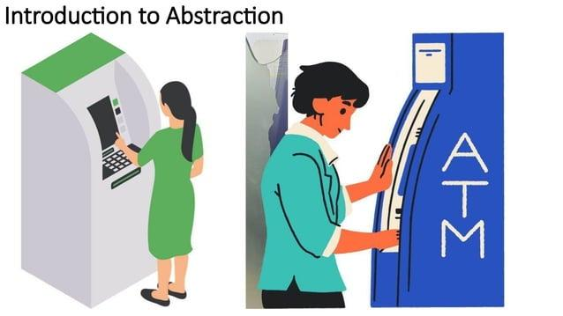
Abstraction in C++

Slide 4
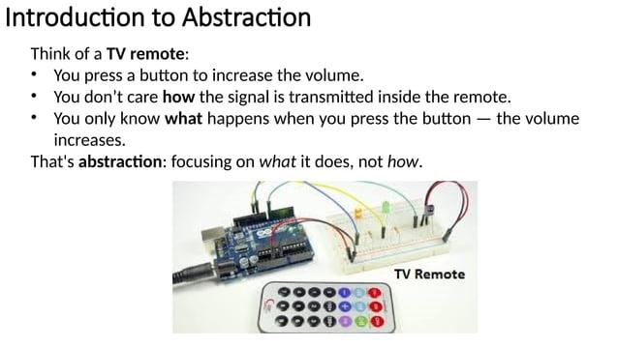
Abstraction Example
Real-World Example: Think of a TV remote.
you press a button to increase the volume
you only care that the volume increases.
You do not need to understand how the internal signal is transmitted to make it work.

Slide 5
Abstraction in C++
In C++, abstraction is achieved using:
  Abstract Classes and Pure Virtual Functions

Slide 6
Pure Virtual Functions
Pure Virtual Function: A virtual function that is only declared but not defined (no implementation) in the base class
Syntax of pure virtual function:
A function is made pure virtual by preceding its declaration with the keyword virtual and post-fixing it with zero.
The = 0 :is not a number; It is a syntax rule.explain in next slides

Slide 7
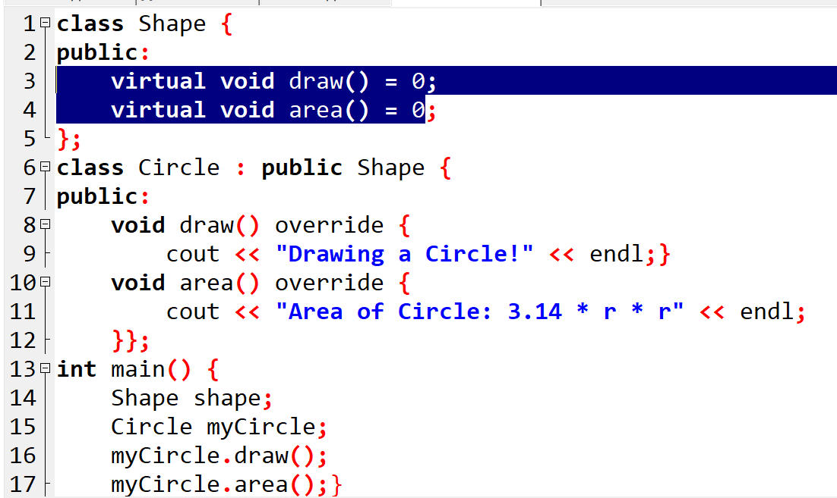
Abstract Class
Abstract Class: An abstract class in C++ is a class that must contain at least one pure virtual function
Class Shape is Abstract class
Pure function(rule)
🛑 ERROR: Cannot create object of abstract class
Constraint: You cannot create an object of an abstract class
It used to provide a common interface for derived class.

Slide 8
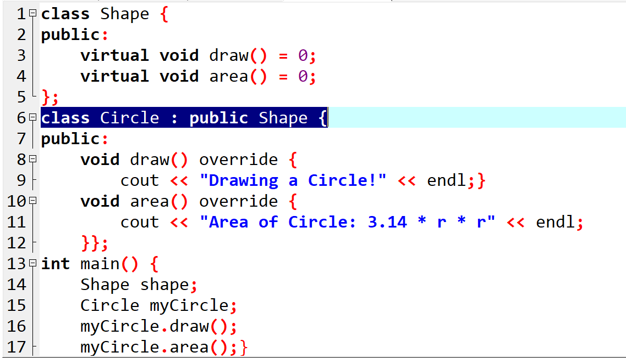

Concrete class
Concrete Class: These are classes from which we can instantiate objects.
Implements all inherited pure virtual functions (if any).
Can be instantiated(i.e., you can create objects from it).
Is not abstract.
We can called this class concrete
Can create object of concrete class

Slide 9
Must driven class override all pure function?
Yes : If the Derived class overrides all pure virtual functions, it becomes a concrete class, and you can create objects of it
No: If the Derived class does NOT override all pure virtual functions, the derived class is still abstract and cannot be instantiated.

Slide 10
Must driven class override all pure function?
Yes : If the Derived class overrides all pure virtual functions, it becomes a concrete class, and you can create objects of it
No: If the Derived class does NOT override all pure virtual functions, the derived class is still abstract and cannot be instantiated.

Slide 11
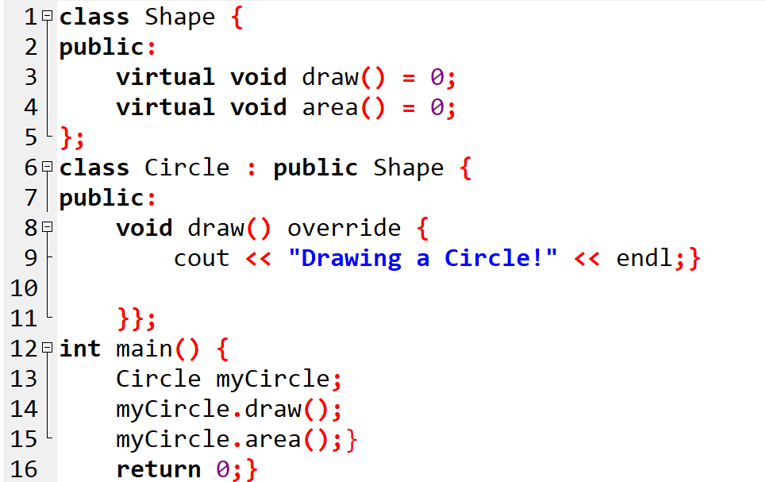
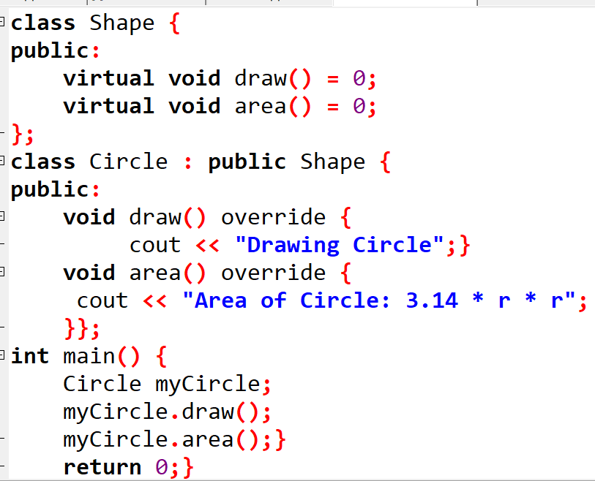
Must driven class override all pure function?
ERROR: driven is abstract class
Can create object
Driven class overrides only pure draw() so it called abstract
Driven class overrides all pure function so it called concerts class

Slide 12
Example:Employes System
1. The Base Class (The Rule) Create an Abstract Class called Employee.
    Data: It must have name and id.
    Rules: It must have two pure virtual functions: calculateSalary() = 0 and displayInfo() = 0.
    Purpose: It acts as a blueprint to ensure all employees have these features.
2. The Derived Class (The Implementation)
    Create a Concrete Class called PermanentEmployee that inherits from Employee.
    Task: You must override both functions from the base class.
    Detail: Inside calculateSalary(), write the math for "Fixed salary + Bonus".

Slide 13
Example
Derived Class (Permanent) | Base Class (Employee) | Feature
Follows the rules (Action) | Sets the rules (Blueprint) | Role
Concrete | Abstract | Type
Overridden (override) | Pure Virtual (= 0) calculateSalary() = displayInfo() = 0. | Functions
Can create objects | Cannot create objects | Objects

Slide 14
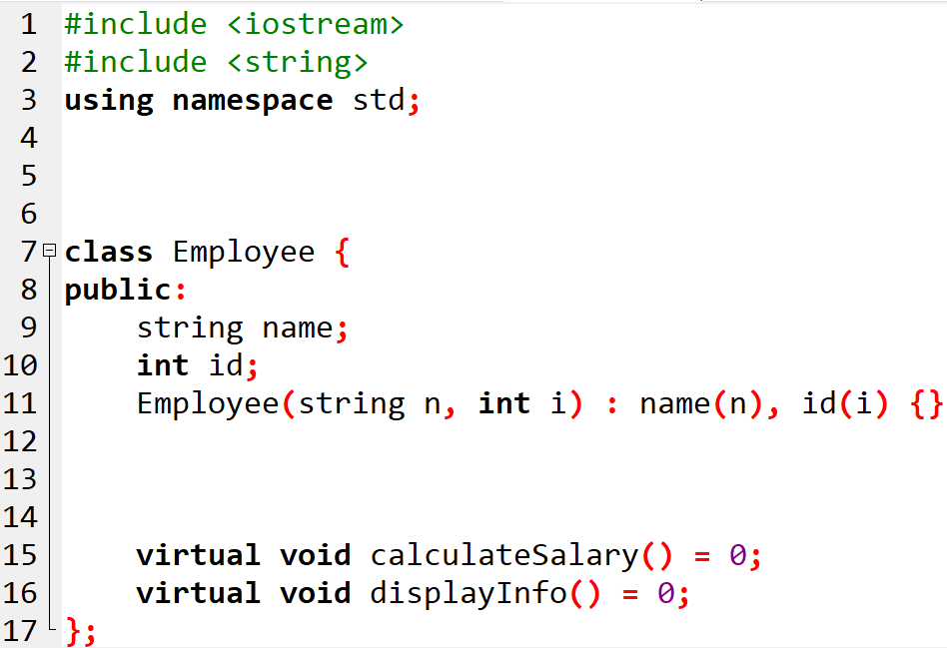
1-Abstract Base
// 1. THE BASE CLASS (The Blueprint)
// This is an Abstract Class because it has pure virtual functions.
// 2- .Rule Virtual Functions
.

Slide 15
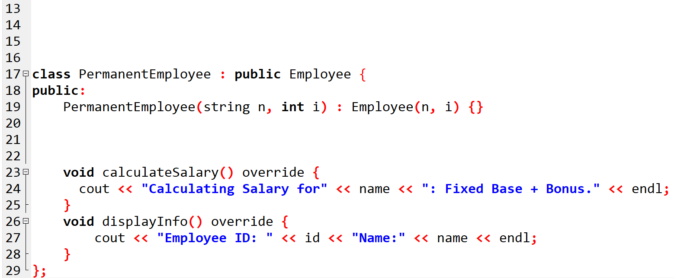
2-Derived Class
// 3. THE DERIVED CLASS (The Implementation)
// This is a Concrete Class because it overrides ALL pure virtual functions.
// 4- We MUST use override to fill in the specific details.
.

Slide 16
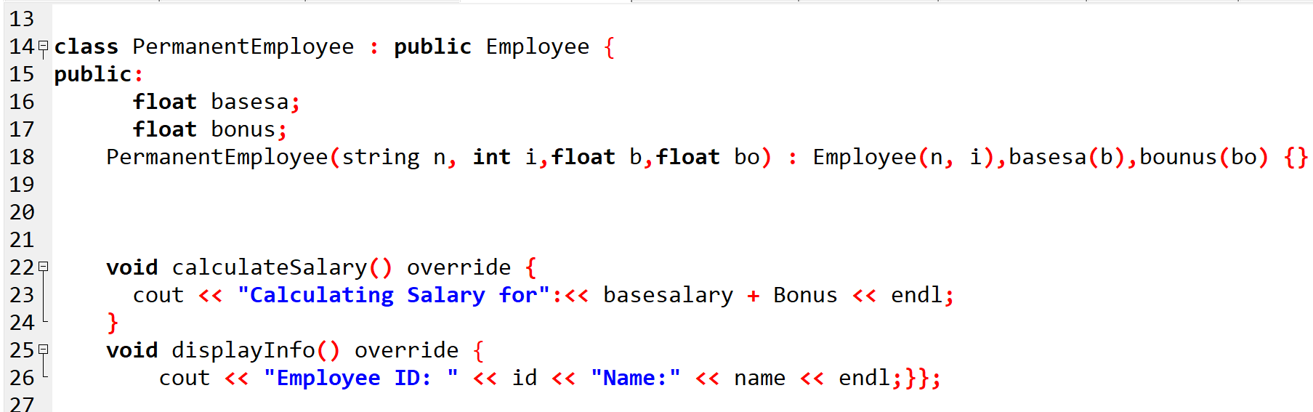
2-Derived Class
// 3. THE DERIVED CLASS (The Implementation)
// This is a Concrete Class because it overrides ALL pure virtual functions.
// 4- We MUST use override to fill in the specific details.

Slide 17
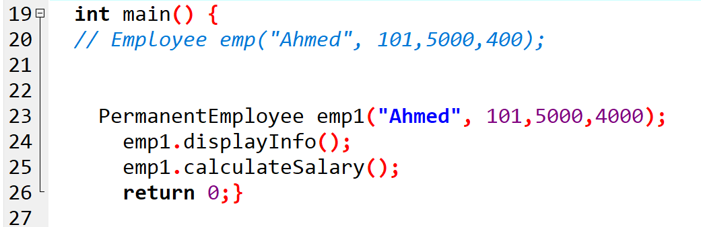
3-Main function
/ ERROR: You cannot create an object of an Abstract Class.
/ We create an object of the Concrete Derived Class instead..

Slide 18
Exercises
Add another Derived Class for another employ called : ContractEmployee
Inheritance: This class also inherits from the Employee base class.
It must fulfill the same rules (the contract) set by the parent class but in a way that fits its specific job type.
Salary Logic: calculate pay based on hours: (Number of Hours × Hourly Rate).

Slide 19
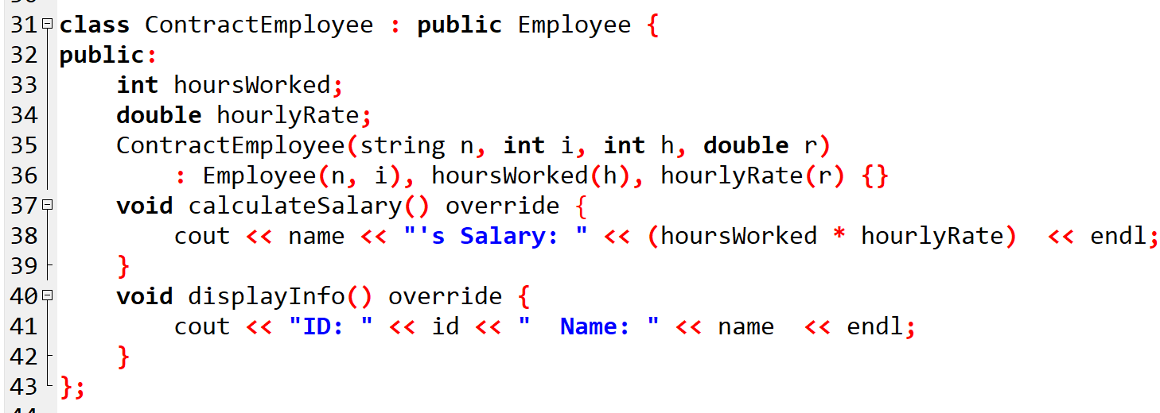
Solution :

Slide 20
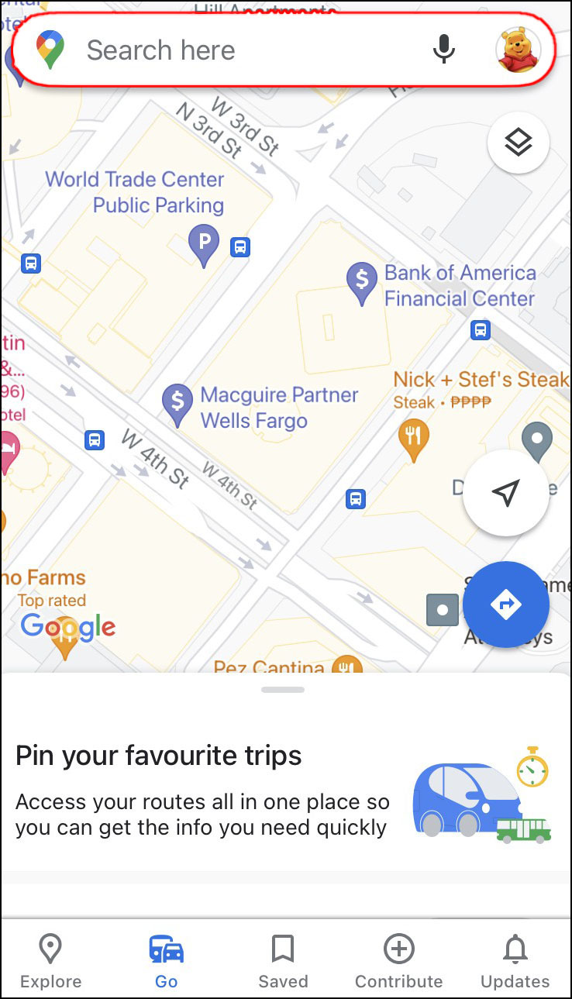
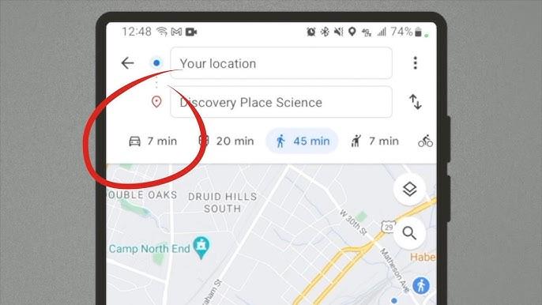
Real Application(GOOGLE MAP)
The "Drive" Button
"A Pure Function is like a question: 'How long will it take?' > A Concrete Class like DriveMode is the Answer: '7 minutes by car!'"

